Slide 1
GB Demand forecasting
Time-Series

Slide 2
Thoughts on Time-Series Forecasting
The parameters of your time-series model should reflect the real-world impact of variables on the dataset, independent of the model’s algorithm.
Therefore, different parameters of the same model convey different views and insights of the dataset.
Models | Details | Examples
Decomposition-based | Deconstruction of time series into components: Trend, Seasonalities, Regressors, Residuals. | Prophet
ARIMA-based | Autoregressive (AR) terms {values}, differencing to achieve stationarity (I), and moving average (MA) terms {residuals}. | SARIMA, SARIMAX, GARCH, etc.
Neural Networks | Use of Transformers, Recurrent Neural Networks (RNN), Convolutional Neural Networks (CNN) | Long Short-Term Memory (LSTM), Temporal Convolutional Networks (TCN)
Ensemble methods | Combines forecasts from multiple models to improve accuracy. | Mix
Notes:
GB Demand with a more flexible trend change might give better insights of the weekly distribution, weather impact, etc. and would most probably forecast the future with higher accuracy. {Good insights into profiling}
GB Demand with small trend changes will give a better view of the long-term impacts of variables affecting the volumes consumed: Efficiency, GDP, Population, Energy Prices, COVID restrictions…
Decomposition-based: Good for understanding of the components and time-series that have seasonalities – therefore: affected by patterns (humans, plants, animals) >> Non-linearities for seasonality.
ARIMA-based: Explainability and very good for non-seasonal data >> although no non-linearities.
Neural Networks:
Transformers use self-attention to capture relationships between all time points simultaneously, handling long-term dependencies well in time-series forecasting.
RNNs process time-series data sequentially, using past information to predict future values, effective for capturing short to medium-term dependencies.
CNNs apply filters to time-series data to detect local patterns and trends, useful for extracting features and short-term dependencies in forecasting.
Transformers
1. Mechanism: Use self-attention to process all time points simultaneously.
2. Strength: Excellent at capturing long-term dependencies.
3. Efficiency: Can handle very long sequences efficiently due to parallel processing.
4. Complexity: Generally more complex and resource-intensive.
Recurrent Neural Networks (RNNs)
1. Mechanism: Process sequences sequentially, passing information from one step to the next.
2. Strength: Good at handling sequential data with short to medium-term dependencies.
3. Efficiency: Can struggle with long sequences due to issues like vanishing gradients.
4. Complexity: Simpler than transformers, but can become complex with layers like LSTM or GRU for improved long-term dependency handling.
Convolutional Neural Networks (CNNs)
1. Mechanism: Apply filters to detect local patterns and features.
2. Strength: Effective at capturing short-term dependencies and local trends.
3. Efficiency: Efficient at processing data in parallel, but mainly captures local context.
4. Complexity: Less complex than transformers, relatively straightforward to implement.

Slide 3
Why Prophet? in Power Demand Forecasting
Curve fitting problem.
Open-box: Clear input components, parameters, outputs, and optimization algorithms. Not neural networks (i.e., not explainable).
Trend, Daily/Weekly/Yearly Seasonality, Holidays, External regressors...
Weights, values of components are part of the output.
Uses “non-linear” algorithms for seasonality– but can be optimized as a linear model (Fourier Series).
Bayesian statistics to harness prior-knowledge: residuals ~ normal distribution.
Robustness to missing data and outliers:
Data missing handling + Fitting downweighs outliers + L1 loss function > minimizes absolute deviations, not squared + Bayesian inference by sampling.
Notes:
Data missing > out of the optimization problem >> Anyway all the seasonalities are continuous functions, depicting the intrinsic dependence on previous datapoints.
L1 loss function instead of L2 for downweighing outliers. ~ within the Bayesian inference.
MCMC (Markov-Chain Monte Carlo): To get posterior distributions (1000 iterations by default) – State-dependent Bayes Method ran many times.
This is optional. If not used, the prior distributions are used.

Slide 4
Statistical Blogs’ input
ARIMA: ~ short-term forecasting.
Evolves in time.
Future values depend on past values in a sequential time-dependent manner.
Relationship between lags of past observation & their errors.
So future predictions errors are assumed to be 0 >> increased uncertainty as forecasts extend out.
Prophet: ~ long-term forecasting.
Curve-fitting problem: regression data.
Combination of components (trend, seasonality, holidays, regressors…) by fitting curves to data.
Weights, values of components are part of the output.
Prophet’s outputs regarding the components of the time-series are helpful to stir the short-term forecast.

Slide 5

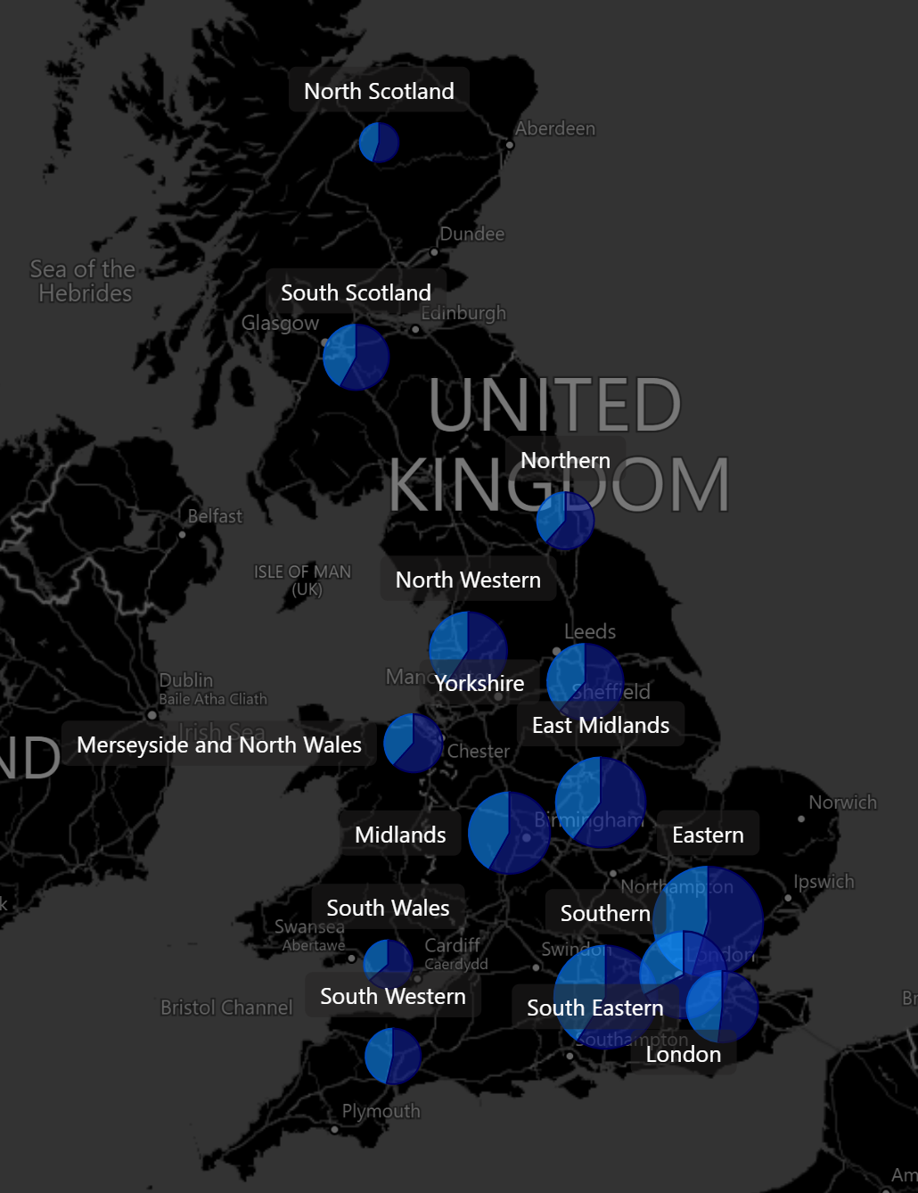
GB Gross Demand ETL ELEXON**
1. Getting needed dataflows:
- D0043: GSP Group Correction Factors.
- D0018: Profile Class Coefficients.
- DXX: Transmission Loss Multipliers.
- D0265: Line Loss Factors.
2. Processing P315 Reports using previous dataflows:
- P0276: GSP Group Consumption Reports (HH-metered).
- P0277: Group Market Matrix Report (NHH-metered)
3. Processing T-connected and D-connected Demand
- Grouping NHH and HH metered data + sectoral split by CCC (Consumption Component Class) → P315 Gross GSP Demand.
- Processing T-connected demand data (half-hourly) from the CDCA-I042 dataflow.
4. Merging the GSP gross demand data with the T-connected demand data
- Total GB Gross Demand by GSP, half-hourly granularity.
Glossary:
- HH: Half-Hourly.
- NHH: Non-HH
- GSP: Grid Supply Point
*** https://github.com/pcpp94/elexon_pipeline_GB_demand
Notes:
https://github.com/pcpp94/elexon_pipeline_GB_demand

Slide 6
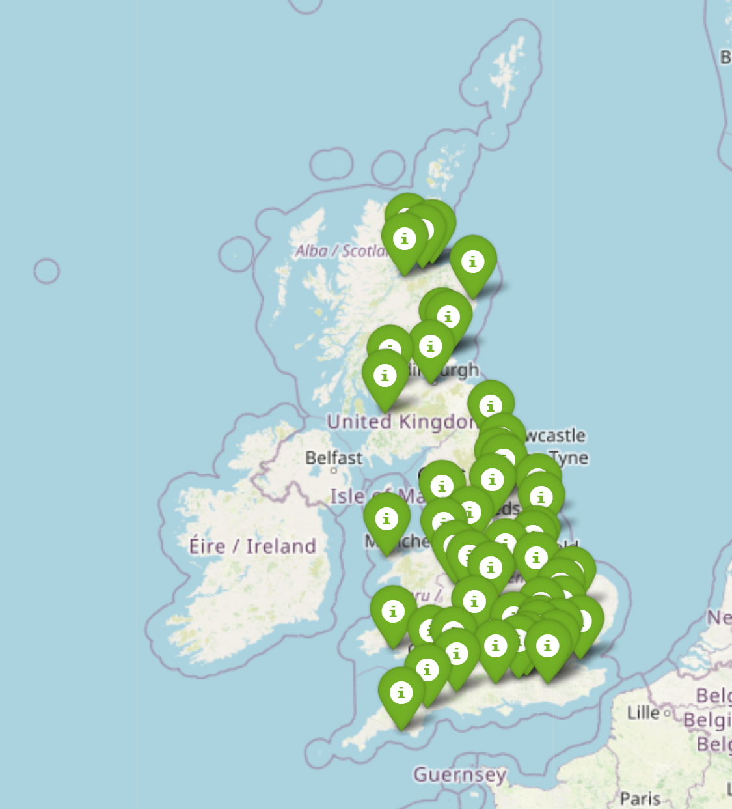
Weather Data ETL Meteostat**
Mapping the closest weather stations to each GSP area
['Kinloss', 'Wick', 'Aberdeen / Dyce', 'Eskdalemuir', 'Leuchars', 'Leeming', 'Waddington', 'Shawbury', 'Aberporth', 'Lyneham', 'London Heathrow Airport', 'Manston', 'Camborne', 'Bournemouth Airport']

Slide 7
Different Granularities, Different Insights…
Hourly:
- Weather impact on the hourly volume ± (daily shape).
- Seasonality impact on the hourly volume.
- Holiday impact on the hourly volume ± (daily profile).
- Change of the daily shape throughout the weeks, months, years.
Daily:
- Weather impact on the daily volume.
- Seasonality impact on the daily volume.
- Holiday impact on the daily volume.
*Faster to run – straight forward analysis on the impact of holidays on demand.
Monthly:
- Weather/Holidays corrected demand is used as an input (Taking away weather effects and conveying a cleaner timeseries)
- Having these “weather/H-adjusted” volumes allows us to use available indicators as regressors:
(GDP for the Non-domestic demand)
(Population + Prices for the Domestic demand)
Choosing depends on: Data granularity, Compute power, Analysis Requirements.
Notes:
GB Demand with a more flexible trend change might give better insights of the weekly distribution, weather impact, etc. and would most probably forecast the future with higher accuracy. {Good insights into profiling}
GB Demand with small trend changes will give a better view of the long-term impacts of variables affecting the volumes consumed: Efficiency, GDP, Population, Energy Prices, COVID restrictions…

Slide 8

Prophet forecasting*
Underlying components and logic.
Using Hyperopt to optimize hyperparameter selection
*Bayesian structural time series modeling
Notes:
What it does: breaking down the time series into interpretable components and applying Bayesian inference to update forecasts based on new data

Slide 9
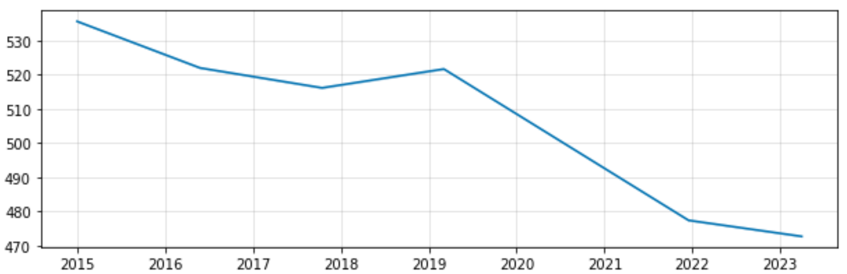
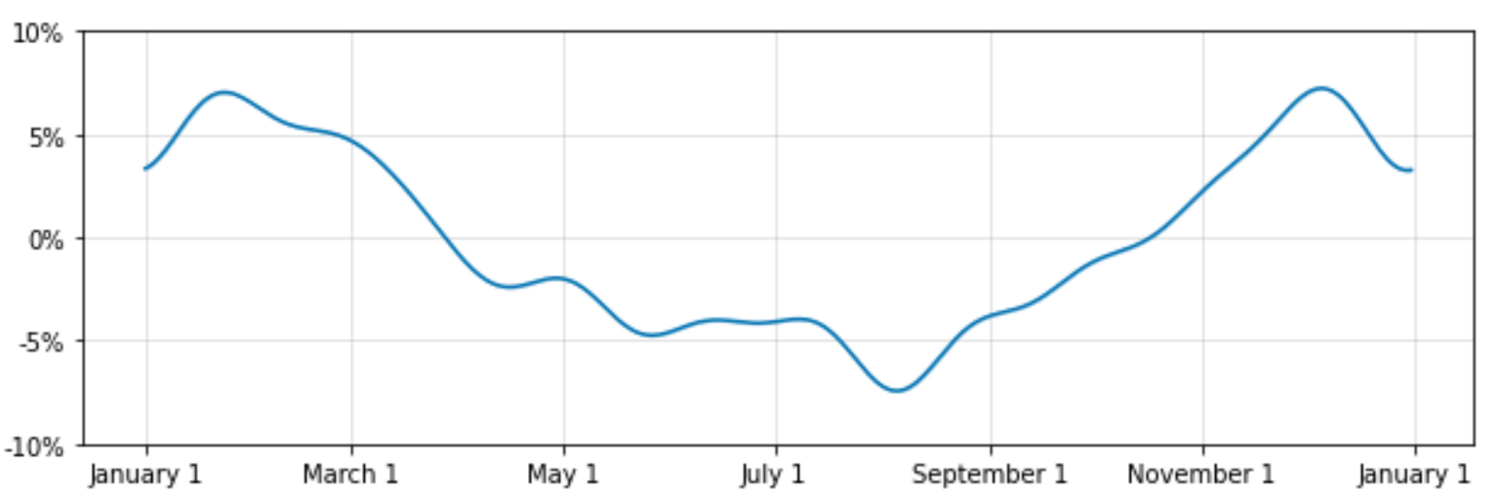

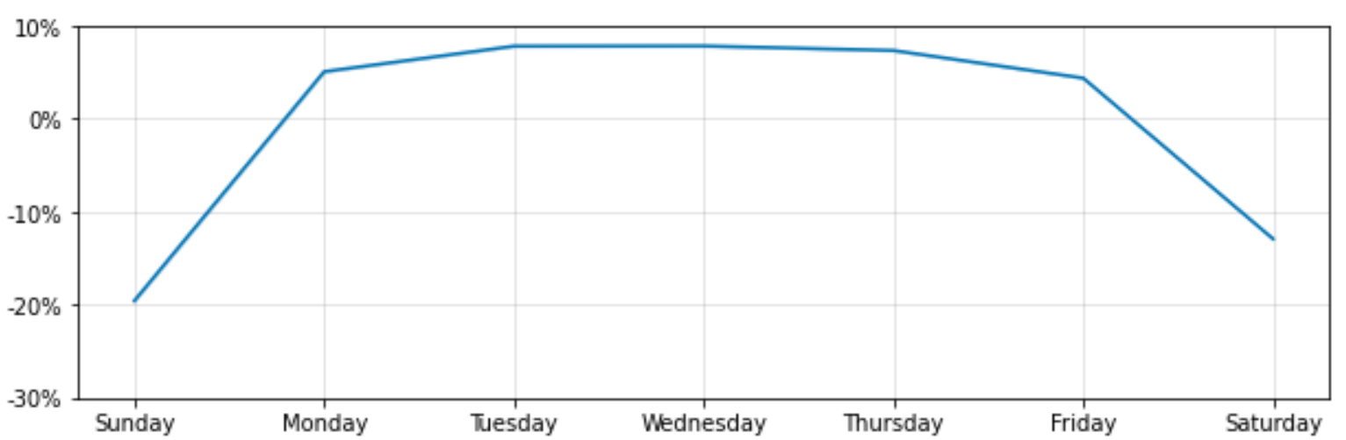
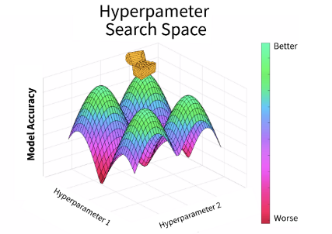
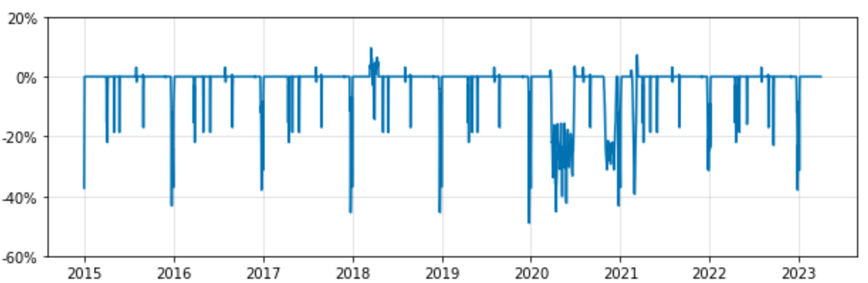
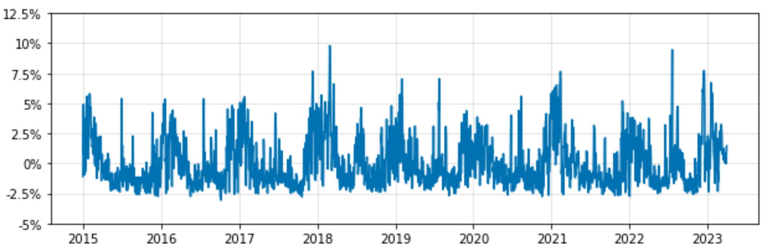
Non-Domestic Daily Model
Signal Breakdown
Trend
Time Series
Signal
Noise [Error]
Yearly Seasonality
Hyper-parameter tuning
Hyperparameters: regularization of Objective Function’s coefficients.
Weekly Seasonality
Holidays
Weather
Regressors
Notes:
Out of:
14 GSP areas
Domestic/Non-domestic by area.
Understanding the impact of all these Daily // Hourly if you have // variables altogether.

Slide 10
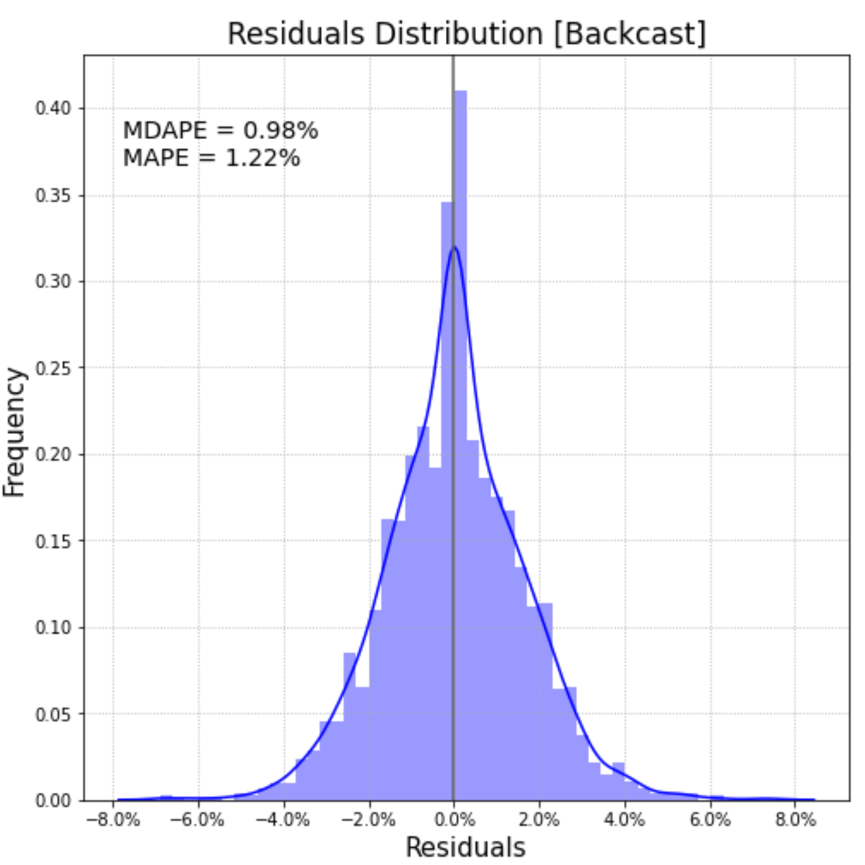
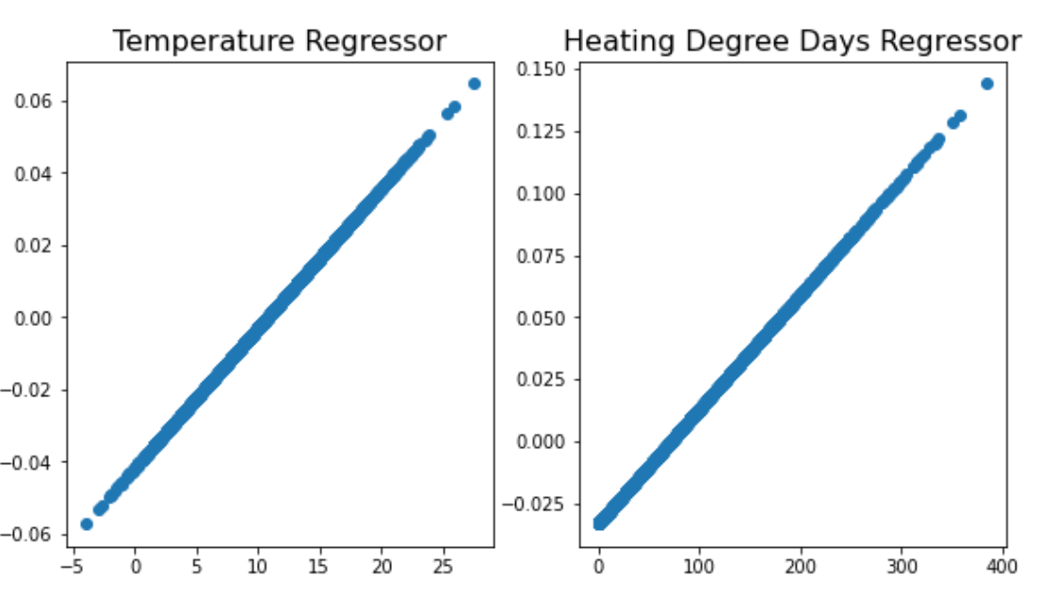
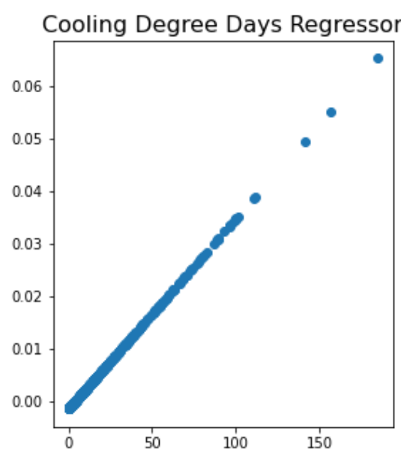
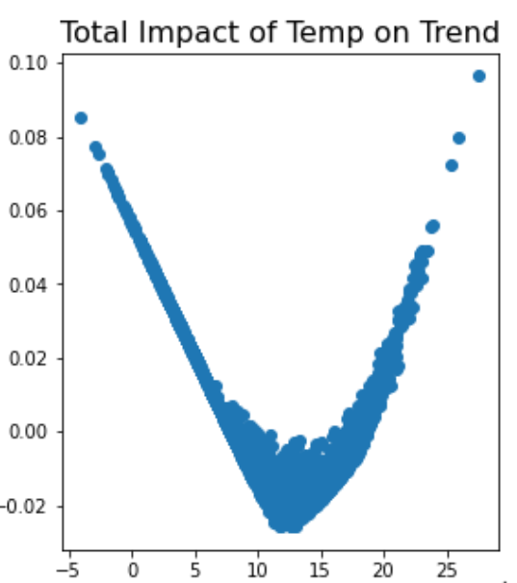
Temperature Regressors
Overcoming linear constraints
Noise [Error]
Example of very straightforward analysis enabled by decomposing Demand.
Non-Domestic Daily Model
Time Series
Signal
Noise [Error]
Hyper-parameter tuning
Hyperparameters: regularization of Objective Function’s coefficients.
The GWh/GDP ratio shows that the level of efficiency gains / behind-the-meter deployment has remained relatively constant under our assumptions.
Notes:
Out of:
14 GSP areas
Domestic/Non-domestic by area.

Slide 11
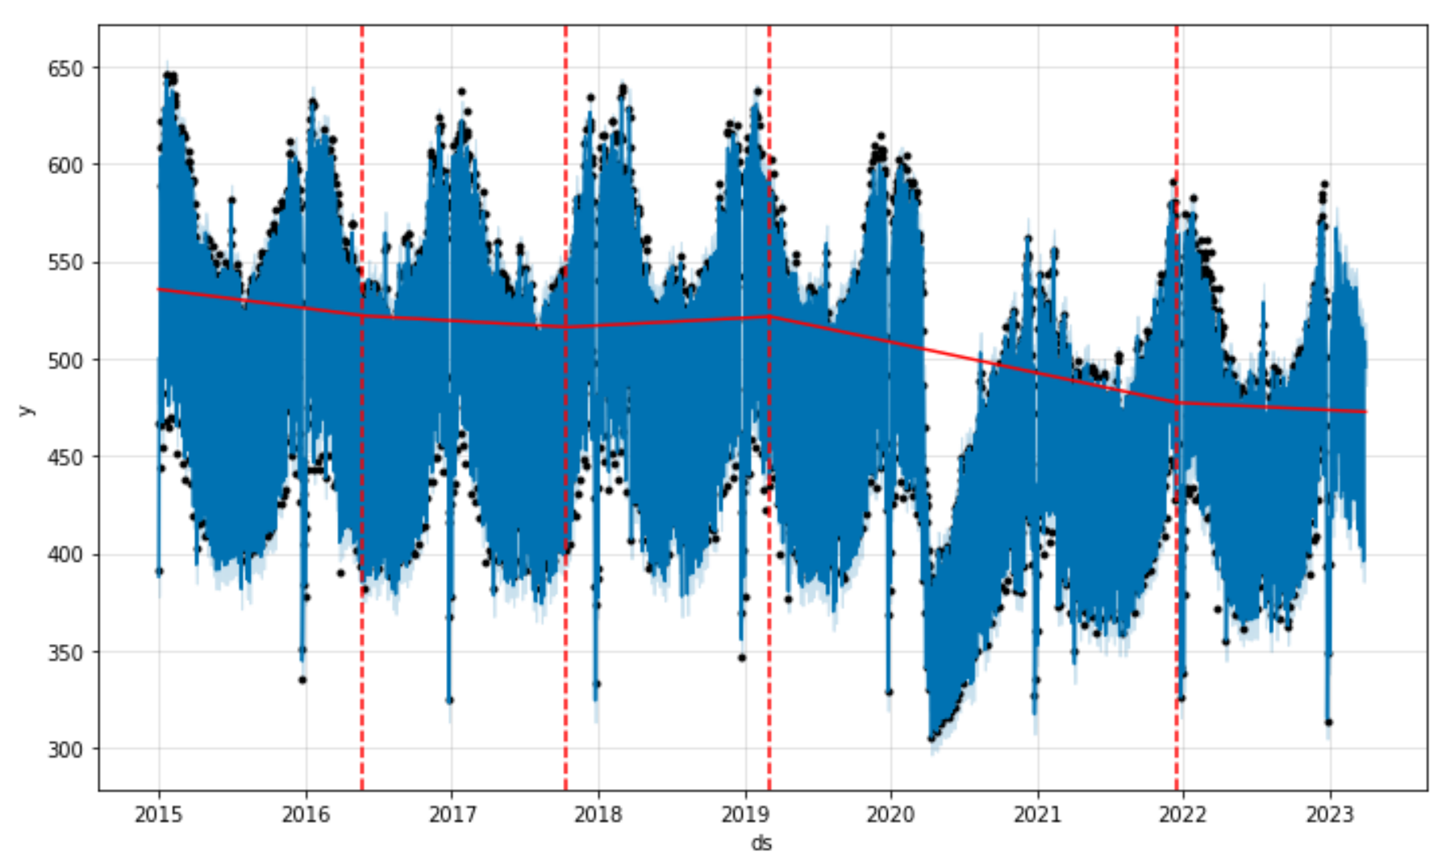
Temperature Regressors
Overcoming linear constraints
Noise [Error]
Forecast + Trend Changepoints
Non-Domestic Daily Model
Time Series
Signal
Noise [Error]
Hyper-parameter tuning
Hyperparameters: regularization of Objective Function’s coefficients.
Notes:
Out of:
14 GSP areas
Domestic/Non-domestic by area.

Slide 12

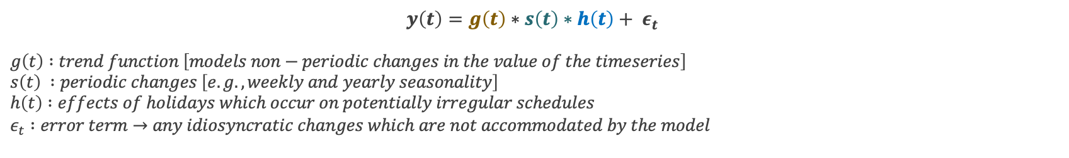

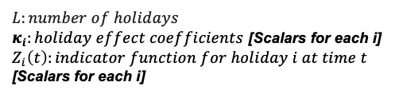
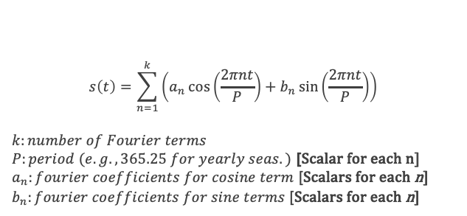

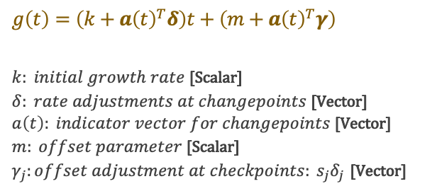
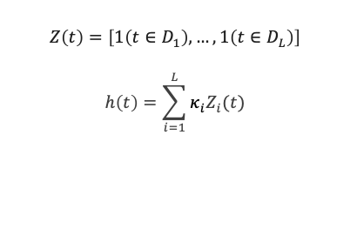
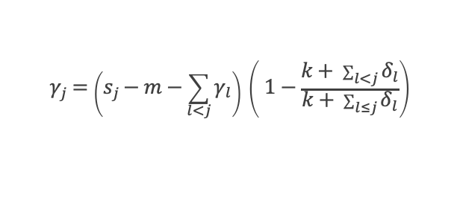

Prophet Objective Function
Forecasting – Decomposable time-series model
Run fourier_series_graphical.py http://127.0.0.1:8050/
Trend Function
Seasonality Function
$$y\left(t\right)=g\left(t\right)∗s\left(t\right)∗h\left(t\right)+ ε_{t}$$
$$g\left(t\right) :trend function \left[models non−periodic changes in the value of the timeseries\right] \\ s\left(t\right) :periodic changes \left[e.g., weekly and yearly seasonality\right] \\ h\left(t\right) :effects of holidays which occur on potentially irregular schedules \\ ε_{t} :error term→any idiosyncratic changes which are not accommodated by the model$$
Holidays
Example: Yearly
Adjustments at changepoints j
$$g\left(t\right)=\left(k+a{\left(t\right)}^{T}δ\right)t+\left(m+a{\left(t\right)}^{T}γ\right)$$
$k: initial growth rate$ [Scalar] $δ: rate adjustments at changepoints$ [Vector] $a\left(t\right): indicator vector for changepoints$ [Vector] $m: offset parameter$ [Scalar] $γ_{j}:offset adjustment at checkpoints: s_{j}δ_{j}$ [Vector]
$$s\left(t\right)=\sum_{n=1}^{k}{\left(a_{n}\cos\left(\frac{2πnt}{P}\right)+b_{n}\sin\left(\frac{2πnt}{P}\right)\right)}$$
$$k:number of Fourier terms$$
$P:period (e.g., 365.25 for yearly seas.)$ [Scalar for each n]
$a_{n}:fourier coefficients for cosine term$ [Scalars for each n]
$b_{n}:fourier coefficients for sine terms$ [Scalars for each n]
$$Z\left(t\right)=\left[1\left(t∈D_{1}\right),…, 1\left(t∈D_{L}\right)\right]$$
$$h\left(t\right)=\sum_{i=1}^{L}{κ_{i}Z_{i}(t)}$$
$$h\left(t\right)=z\left(t\right)κ$$
$$L:number of holidays$$
$κ_{i}:holiday effect coefficients$ [Scalars for each i]
$Z_{i}\left(t\right):indicator function for holiday i at time t$ [Scalars for each i]
$$X\left(t\right)=\left[\cos\left(\frac{2π\left(1\right)t}{365.25}\right),…,\sin\left(\frac{2π\left(10\right)t}{365.25}\right)\right]$$
$$γ_{j}=\left(s_{j}−m−\sum_{l<j}{γ_{l}}\right) \left( 1−\frac{k+ \sum_{l<j}{δ_{l}}}{k+ \sum_{l≤j}{δ_{l}}}\right)$$
$$β={\left[a_{1},b_{1},…, a_{N},b_{N}\right]}^{T}$$
Same concept for the included regressors.
$$s\left(t\right)=X\left(t\right) β$$
Notes:
SHOWING:
The MODEL PARAMETERS, which are the coefficients of the different functions within the objective functions.
Delta (rate of adjustments at changepoints) is a double_exponential so many changes are close to 0, promoting a smooth trend with occasional abrupt changes.
Fourier Series Premise: Given an infinite number of different cosines and sines we can approximate that function to any function.
So, in Prophet the seasonality model is learning a weight for each of the different frequency cos/sin & summing them up together.
a(t):
a_t is a binary vector where each element indicates whether time t is after the corresponding changepoint.
- For example, if there are changepoints at times t_1 and t_2 , then:
a_t = [I(t > t_1), I(t > t_2)]
where I is an indicator function that returns 1 if the condition is true and 0 otherwise.

Slide 13
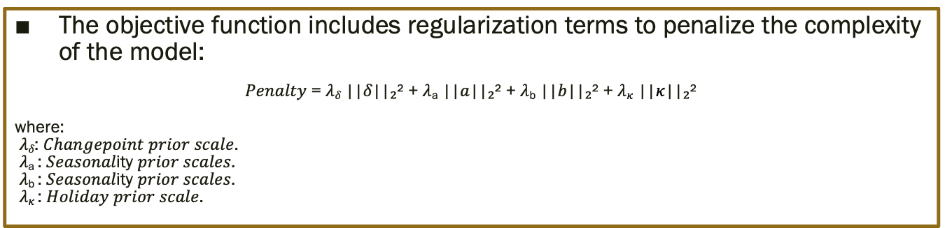
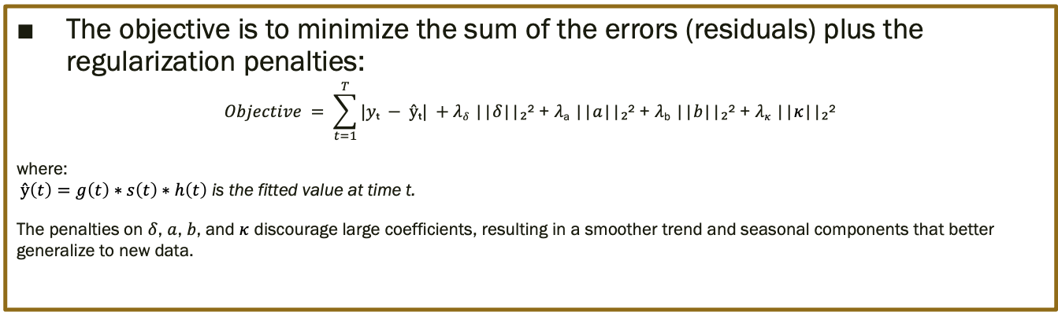
Regularization + Objective Function in classic ML…
The objective function includes regularization terms to penalize the complexity of the model:
𝑃𝑒𝑛𝑎𝑙𝑡𝑦 = 𝜆_{𝛿} ||𝛿||₂² + 𝜆_{a} ||$a$||₂² + 𝜆_{b} ||$b$||₂² + 𝜆$κ$ ||$κ$||₂²
where: 𝜆_{𝛿}: 𝐶ℎ𝑎𝑛𝑔𝑒𝑝𝑜𝑖𝑛𝑡 𝑝𝑟𝑖𝑜𝑟 𝑠𝑐𝑎𝑙𝑒. 𝜆_{a} : 𝑆𝑒𝑎𝑠𝑜𝑛𝑎𝑙ity 𝑝𝑟𝑖𝑜𝑟 𝑠𝑐𝑎𝑙𝑒𝑠. 𝜆_{b} : 𝑆𝑒𝑎𝑠𝑜𝑛𝑎𝑙ity 𝑝𝑟𝑖𝑜𝑟 𝑠𝑐𝑎𝑙𝑒𝑠. 𝜆$κ$: 𝐻𝑜𝑙𝑖𝑑𝑎𝑦 𝑝𝑟𝑖𝑜𝑟 𝑠𝑐𝑎𝑙𝑒.
Equivalent:
L1 loss function for more robustness to outliers because it penalizes them linearly.
L2 (Ridge Regression) penalizes the hyperparameters quadratically.
The objective is to minimize the sum of the errors (residuals) plus the regularization penalties:
$$Objective = \sum_{t=1}^{T}{|yₜ − ŷₜ|} +\text{λ}\text{δ}\text{ ||}\text{δ}\text{||₂² + }\text{λ}\text{a}\text{ ||}a\text{||₂² + }\text{λ}\text{b}\text{ ||}b\text{||₂² + }\text{λ}κ\text{ ||}κ\text{||₂²}$$
where: $ŷ\left(t\right)=g\left(t\right)∗s\left(t\right)∗h\left(t\right)$ is the fitted value at time t.
The penalties on $δ$, $a$, $b$, and $κ$ discourage large coefficients, resulting in a smoother trend and seasonal components that better generalize to new data.
Notes:
SHOWING:
The MODEL HYPERPARAMETERS, which affect the model parameters quadratically to make them smoother > Regularization L2 here.
To explain the L2 in minimizing the objective function:
The functions is minimizing the ERRORS, which depend on different values for each variable.
However, the L2 affects all variables in the same way, it makes them be lower.
Therefore, it ends up smoothing and making these coefficients sensible numbers, not super large.

Slide 14

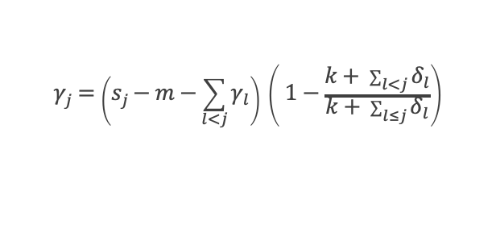

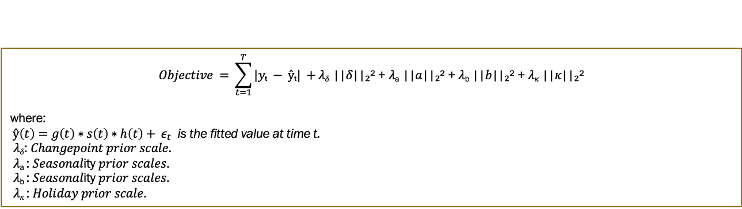

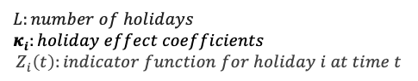
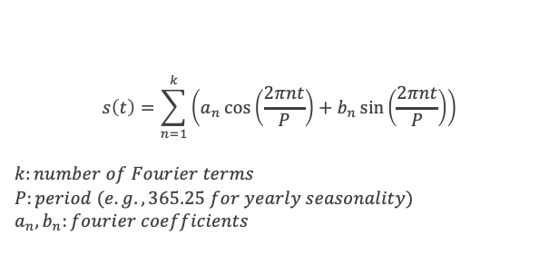

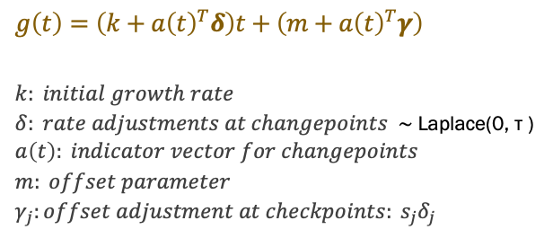
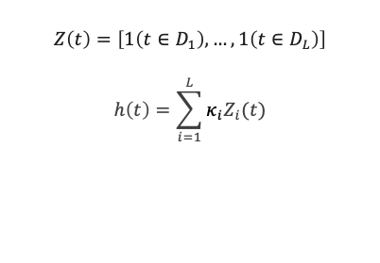
Objective Function & Hyperparameters in classic ML…
$$Objective = \sum_{t=1}^{T}{|yₜ − ŷₜ|} +\text{λ}\text{δ}\text{ ||}\text{δ}\text{||₂² + }\text{λ}\text{a}\text{ ||}a\text{||₂² + }\text{λ}\text{b}\text{ ||}b\text{||₂² + }\text{λ}κ\text{ ||}κ\text{||₂²}$$
where: $ŷ\left(t\right)=g\left(t\right)∗s\left(t\right)∗h\left(t\right)+ ε_{t}$ is the fitted value at time t.
𝜆_{𝛿}: 𝐶ℎ𝑎𝑛𝑔𝑒𝑝𝑜𝑖𝑛𝑡 𝑝𝑟𝑖𝑜𝑟 𝑠𝑐𝑎𝑙𝑒. 𝜆_{a} : 𝑆𝑒𝑎𝑠𝑜𝑛𝑎𝑙ity 𝑝𝑟𝑖𝑜𝑟 𝑠𝑐𝑎𝑙𝑒𝑠. 𝜆_{b} : 𝑆𝑒𝑎𝑠𝑜𝑛𝑎𝑙ity 𝑝𝑟𝑖𝑜𝑟 𝑠𝑐𝑎𝑙𝑒𝑠. 𝜆$κ$: 𝐻𝑜𝑙𝑖𝑑𝑎𝑦 𝑝𝑟𝑖𝑜𝑟 𝑠𝑐𝑎𝑙𝑒.
These are the hyperparameters directly affecting the coefficients of the Objective Function.
Trend Function
Seasonality Function
Holidays
coefficient
coefficients
coefficient
Hyperparameters
Example: Yearly
Adjustments at changepoints j
$$g\left(t\right)=\left(k+a{\left(t\right)}^{T}δ\right)t+\left(m+a{\left(t\right)}^{T}γ\right)$$
$$k: initial growth rate$$ $δ: rate adjustments at changepoints$ ∼ Laplace(0, τ ) $$a\left(t\right): indicator vector for changepoints \\ m: offset parameter \\ γ_{j}:offset adjustment at checkpoints: s_{j}δ_{j}$$
$$s\left(t\right)=\sum_{n=1}^{k}{\left(a_{n}\cos\left(\frac{2πnt}{P}\right)+b_{n}\sin\left(\frac{2πnt}{P}\right)\right)}$$
$$k:number of Fourier terms$$
$$P:period (e.g., 365.25 for yearly seasonality)$$
$$a_{n}, b_{n}:fourier coefficients$$
$$Z\left(t\right)=\left[1\left(t∈D_{1}\right),…, 1\left(t∈D_{L}\right)\right]$$
$$h\left(t\right)=\sum_{i=1}^{L}{κ_{i}Z_{i}(t)}$$
$$h\left(t\right)=z\left(t\right)κ$$
$$L:number of holidays$$
$$κ_{i}:holiday effect coefficients$$
$$Z_{i}\left(t\right):indicator function for holiday i at time t$$
$$X\left(t\right)=\left[\cos\left(\frac{2π\left(1\right)t}{365.25}\right),…,\sin\left(\frac{2π\left(10\right)t}{365.25}\right)\right]$$
$$γ_{j}=\left(s_{j}−m−\sum_{l<j}{γ_{l}}\right) \left( 1−\frac{k+ \sum_{l<j}{δ_{l}}}{k+ \sum_{l≤j}{δ_{l}}}\right)$$
$$β={\left[a_{1},b_{1},…, a_{N},b_{N}\right]}^{T}$$
Same concept for the included regressors.
$$s\left(t\right)=X\left(t\right) β$$
Notes:
Showing the coefficients being affected by the hyperameters.

Slide 15
Bayesian probabilities Refreshing memory
Represents a degree of belief or uncertainty about an event, updated as new evidence becomes available.
“Probabilities” (beliefs) change as you learn more.
You need to input “prior” beliefs and data (residuals/errors follow a normal distribution).
Make sense in time-series forecasting because:
They allow for updating predictions as new data arrives.
Bayesian models provide uncertainty estimates for future values.
Handle non-stationarity.
Incorporate prior knowledge (such as past patterns or domain expertise).
Notes:
Uncertainty estimation in Forecasts.
The uncertainty estimation of the future depend on the delta component (trend changes). Assuming trend changes’ frequency and size remain the same.

Slide 16
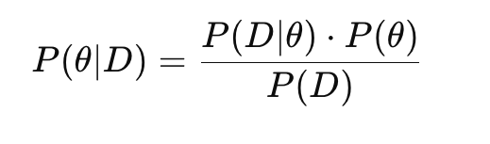
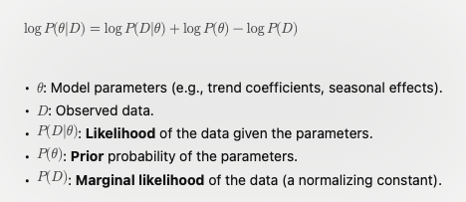
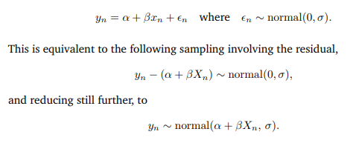
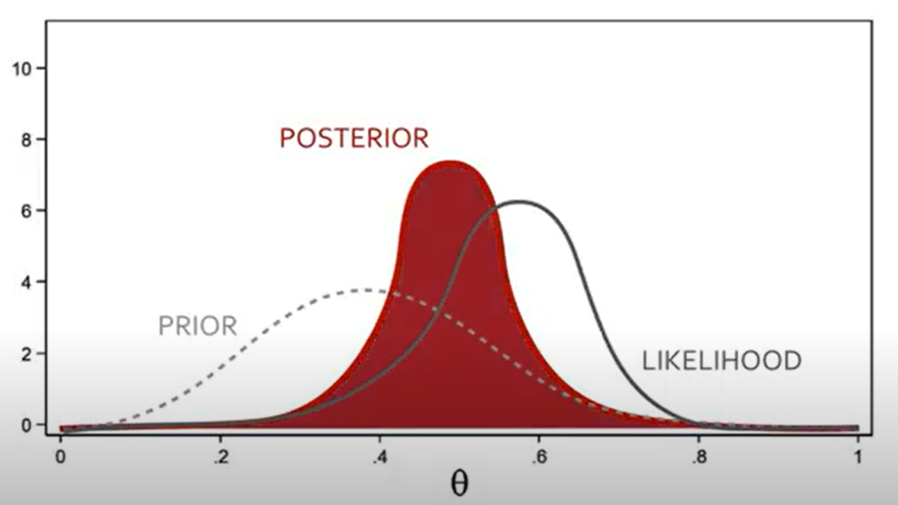
Model Fitting, Posterior Distribution
Most calculations use Bayesian inference.
Note: We clearly want the residuals to follow a normal distribution → We might as well input and use that information.
Logarithm of the posterior probability (the Log transforms products into a sum, less computationally intensive).
Log-likelihood is used for:
Optimization for MAP Estimation.
MCMC Sampling for Posterior Distribution.
Posterior log-likelihood
Formulating a linear regression for Bayesian Inference
Using L-BFGS for optimization by default. In Stan.
Notes:
Posterior Log-Likelihood == Logarithm of the posterior probability.
Combines:
How well the model fits the data (likelihood).
Prior beliefs about the parameters (priors). [hyperparams]
Linear regression using L-BFGS:
Mathematical input into STAN.
STAN: Bayesian inference software.
Widely used, conference this month at the University of Oxford.
Meta (Facebook) uses it clearly.

Slide 17
Model Fitting, Posterior Distribution
The errors/residuals of y are normally distributed. That’s our first assumption and “prior distribution”.
For each point in time, the observed value of y is expected to be near the predicted mean (the sum of the components), but the actual value could vary due to random noise, which follows a normal distribution.
Posterior log-likelihood
Formulating a linear regression for Bayesian Inference
Using L-BFGS for optimization by default. In Stan.
Notes:
Posterior Log-Likelihood == Logarithm of the posterior probability.
Combines:
How well the model fits the data (likelihood).
Prior beliefs about the parameters (priors). [hyperparams]
Linear regression using L-BFGS:
Mathematical input into STAN.
STAN: Bayesian inference software.
Widely used, conference this month at the University of Oxford.
Meta (Facebook) uses it clearly.

Slide 18
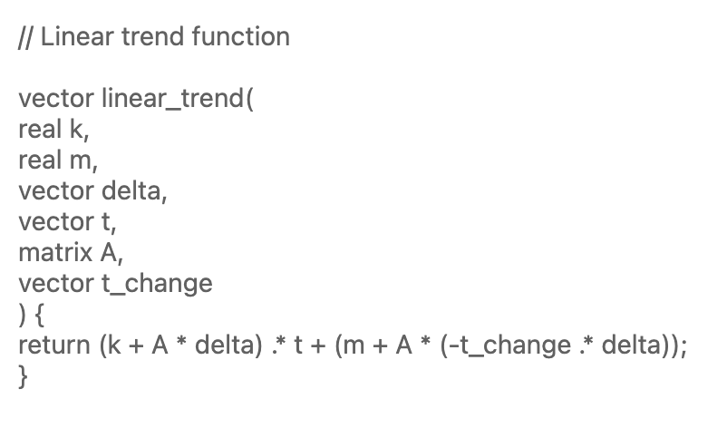
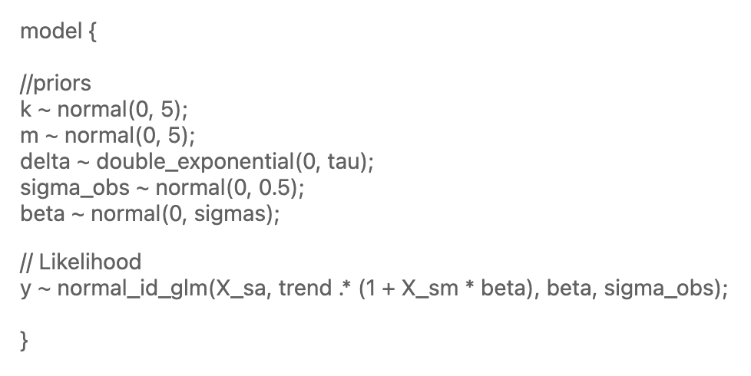
Stan Optimization Algorithm
Stan code
Distributions Syntax:
“double_exponential(0,tau)” is a Laplace(0, tau) distribution.
//Priors:
K: growth rate of the trend.
M: offset/intercept of the trend.
Sigma_obs: noise or error.
Delta: Growth rate changes at changepoints (trend change). [Limited by changepoint_range]
Beta: coefficients for seasonality, regressors, holidays, components in the model.
Hyperparameters:
Tau: changepoint_prior_scale (how tightly or loosely changepoints are constained).
Sigmas: seasonality_prior_scale (how much seasonality can vary) and holidays_prior_scale (for holidays).
//Likelihood:
Normal_id_glm: function for generalized Linear Model (GLM) with a normal likelihood.
X_sa: additive regressor matrix (like holidays or external factors).
X_sm: multiplicative regressor matrix.
y ~ normal_id_glm:
The observed data y is assumed to come from a normal distribution with a mean defined by the model and standard deviation sigma_obs.

Slide 19
Stan’s used likelihood function
y ~ normal_id_glm(x, alpha, beta, sigma)
Paramters:
y: the observed or predicted outcome (dependent variable).
X: design matrix or independent variables: Matrix[row,col]:
row: observation.
col: feature.
alpha: intercept terms.
beta: coefficients for the independent variables.
sigma: standard deviation of errors (residuals). Determines the variance of the distribution of y around the predicted value.
Process:
Linear combination = alpha + X * beta
y modeled as a normal distribution: y ~ N(alpha + X*beta, sigma)
In Prophet’s case:
The whole “multiplicative” model is the variable alpha, including beta in its formula.
The “additive” model is the X * beta variables. In our case X is always a 0s matrix.

Slide 20
MAP vs. MCMC
Both infer parameters based on observed data and prior beliefs.
MAP: Maximum a Posteriori estimation.
Goal: Find the single best set of parameters that maximize the posterior distribution.
By optimizing the objective function (posterior likelihood) using gradient descent-based algorithm (L-BFGS).
Maximization of posterior distribution (Optimization) → Most probable single set of parameters | Given the data and priors.
Conveys a single point estimate: maximum posterior distribution (No uncertainty quantification).
Faster, less computationally expensive.
In complex scenarios, it might miss multiple peaks in the posterior.
MCMC: Markov Chain Monte Carlo sampling.
Goal: explore the full posterior distribution by drawing many samples from it.
Sampling algorithms: NUTS, HMC → smart random-walking.
Conveys a collection of samples representing the posterior (Parameter’s uncertainty quantified)
It’s a stochastic simulation → slower, computationally expensive.
Can capture multi-modality in the posterior.
Notes:
The posterior probability distribution is the updated probability of a parameter after observing data, combining prior beliefs with the likelihood of the observed data using Bayes’ theorem.
MAP → Optimization algorithm: Gradient Descent.
It’s like a MLE (Maximum likelihood estimation)
Key difference: MAP incorporates prior information about the parameters. While MLE maximizes the likelihood function based solely on the data
MCMC → Sampling algorithm: No-U-Turn Sampler (NUTS), Hamiltonian Monte Carlo (HMC).
Markov-chains: how many samplings are done (to ensure convergence).
The type of MCMC algorithm used is NUTS which is a type of advanced HMC:
Adaptive step size.
Parameter space exploration is efficient (harnesses the gradient of the posterior distribution)
MAP Estimation Steps:
1. Define the likelihood P(D | \theta) and prior P(\theta).
2. Compute the posterior P(\theta | D) \propto P(D | \theta) P(\theta).
3. Find \theta_{\text{MAP}} = \arg\max_{\theta} P(\theta | D).
MCMC Sampling Steps:
1. Define the likelihood P(D | \theta) and prior P(\theta) .
2. Set up an MCMC algorithm (e.g., Metropolis-Hastings) to sample from P(\theta | D) .
3. Generate a large number of samples \{ \theta^{(i)} \} .
4. Analyze the samples to estimate quantities of interest (mean, variance, credible intervals).

Slide 21
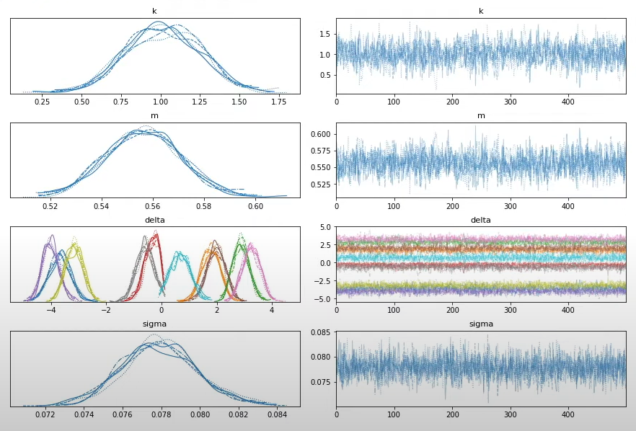
MCMC Process in Prophet
Posterior Distribution: The distribution of the parameter values after sampling, reflecting the uncertainty about each parameter.
Trace: The MCMC sampling chain for each parameter, tracking how the samples evolve over time. A good trace should have stationarity, indicating good mixing and convergence.
In this example there are 10 changepoints, which affect the slope over time.
Posterior Distributions
Trace Plots
Trend Slope
Intercept
Magnitude of change
Error term
Notes:
The trend at any time t is then the base trend k, plus all of the adjustments up to that point.

Slide 22
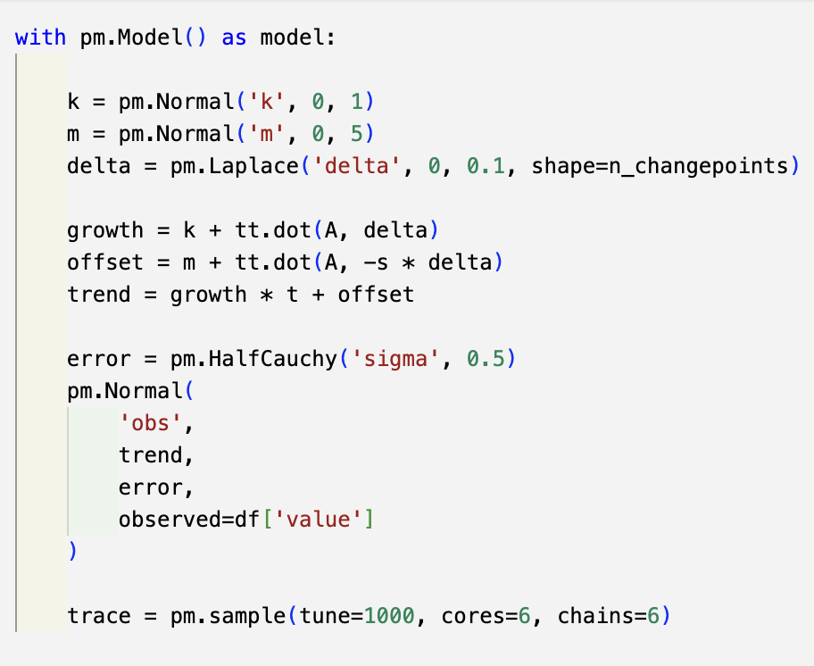
MCMC Process in Prophet
Posterior Distributions
Trace Plots
Trend Slope
Intercept
Magnitude of change
Error term
Notes:
The trend at any time t is then the base trend k, plus all of the adjustments up to that point.
A is a matrix [T,S].
T: time vector.
S: vector[S] t_change; // Times of trend changepoints

Slide 23
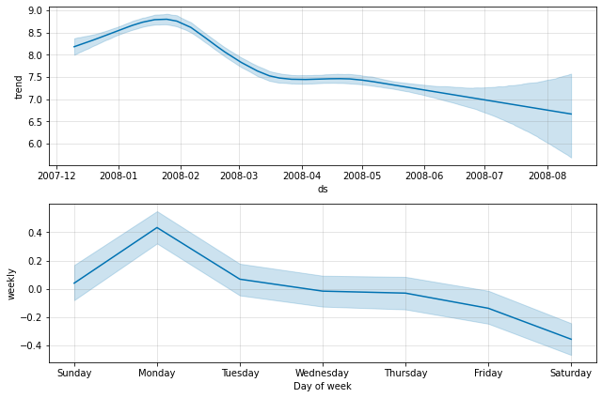
All the Hyperparameters.
seasonality_prior_scale: [0.01, 10] default 10
holidays_prior_scale: [0.01, 10] default 10
changepoint_prior_scale: [0.001, 0.5] default 0.05
mcmc_samples: [boolean] default ‘false’
changepoint_range: [0.8, 0.95] default 0.8
seasonality_mode: [‘additive’, ‘multiplicative’] default ‘additive’
changepoints: [dates] default None
yearly_seasonality: [boolean] default ‘auto’
n_changepoints: [integer number] default 25
weekly_seasonality: [boolean] default ‘true’
daily_seasonality: [boolean] default ‘auto’
holidays: [DataFrame] default None
interval_width: [0.8, 0.95] default 0.8 {confidence level}
uncertainty_samples: [integer number] default 1000
Tune-able
growth: [‘linear’, ‘logistic’] (saturation point?) default ‘linear’
Usually not tune-able
Using MCMC
For trend, seasonalities, regressors, holidays, forecast
Notes:
Regarding the interval_width / confidence level:
Imagine Prophet forecasts that you’ll sell 100 ice creams tomorrow with an 80% uncertainty interval from 90 to 110. This means:
• Most Likely Range: There’s an 80% chance you’ll sell between 90 and 110 ice creams.
>> What do we want to show? What level of confidence in our forecast and the different components?
Model Parameters
growth: String specifying the type of trend to fit. Either 'linear' or 'logistic'.
changepoints: List of dates at which to include potential changepoints. If not specified, potential changepoints are automatically selected.
n_changepoints: Number of potential changepoints to include.
changepoint_range: Proportion of the history in which trend changepoints will be estimated. Defaults to 0.8 for the first 80%.
Trend Parameters
changepoint_prior_scale: Parameter controlling the flexibility of the automatic changepoint selection. Larger values allow for more changepoints.
seasonality_prior_scale: Parameter controlling the strength of the seasonality model.
holidays_prior_scale: Parameter controlling the strength of the holiday components.
mcmc_samples: If greater than 0, will do full Bayesian inference with the specified number of MCMC samples. Defaults to 0 for MAP estimation. [MCMC: Markov Chain Monte Carlo]
interval_width: Width of the uncertainty intervals provided for the forecast. Defaults to 0.8.
Seasonalities
seasonality_mode: Either 'additive' (default) or 'multiplicative'.
yearly_seasonality: Boolean or integer. If True, include yearly seasonality (default). If False, no yearly seasonality. If an integer, specify the Fourier order.
weekly_seasonality: Boolean or integer. Similar to yearly_seasonality, but for weekly data.
daily_seasonality: Boolean or integer. Similar to yearly_seasonality, but for daily data.
seasonality_prior_scale: Parameter controlling the strength of the seasonality model.
Holidays and Events
holidays: DataFrame with columns holiday (name of the holiday), ds (date of the holiday), and optionally lower_window and upper_window for adding days around the date as holiday effect.
holidays_prior_scale: Parameter controlling the strength of the holiday components.
Others 1. uncertainty_samples: Number of simulated draws used to estimate uncertainty intervals.

Slide 24
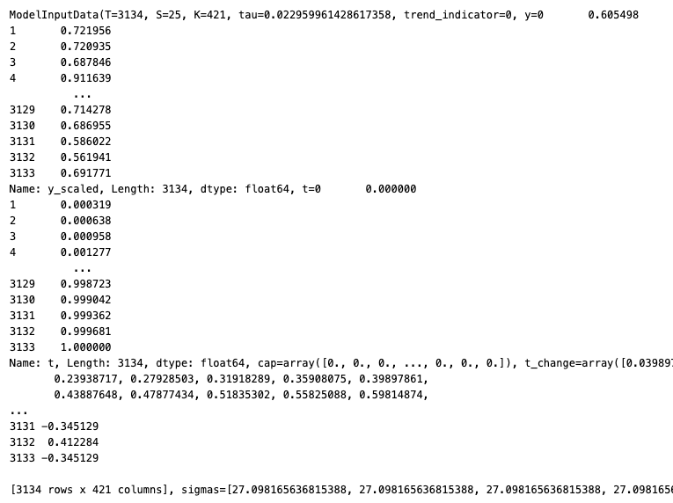
Understanding the Python Model: Initial Parameters
model.preprocess(df):
'K’: number of variables' coefficients.
'S’: number of slope changes (at each changepoint)
'T’: Number of time series’ datetime points.
'X': Dataframe of TxK (each time series datetime point x the variables’ coefficients as columns).
'cap': for logistic growth.
's_a': additive terms.
's_m': multiplicative terms.
'sigmas': Coefficients' prior_scales (Hyperparameters)
't': time.
't_change': value of t at changepoints.
'tau': changepoint prior_scale >> flexibility.
’y’: standardized y values.
Notes:
Preprocess(df):
Shows the input parameters scaled, normalized, etc.
Within Prophet package:
model_inputs: values, inputs, inputted into the model, that are not going to change through modelling. (model.calculate_initial_params())
intial_params: intial parameters that will change through iterations of the optimization. (model.params)
'K’: number of variables' coefficients [BETA size in model.params].
'S’: number of slope changes (at each changepoint) [DELTA size in model.params].
'T’: number of estimated values of the trend component of the time series at each time point. [TREND size in model.params].
'X': Dataframe of TxK (each time series datetime point x the variables’ coefficients as columns).

Slide 25
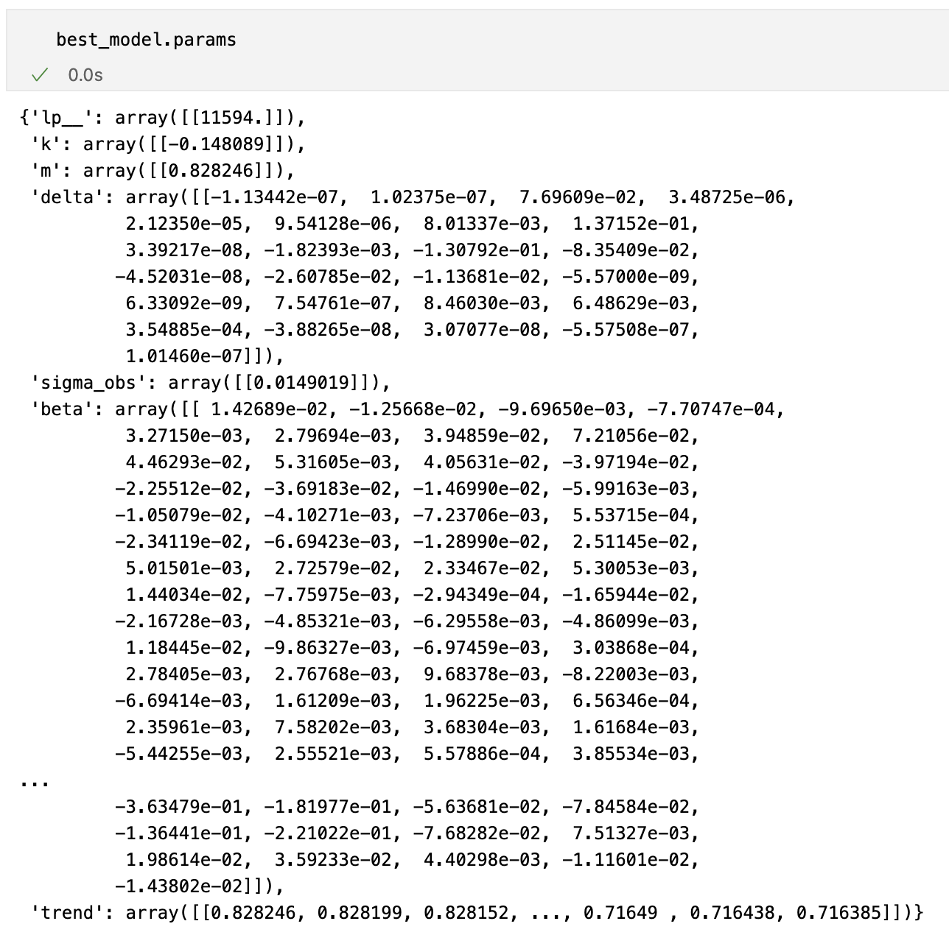
Understanding the Python Model: Fitted Parameters
Lp__(Mx1): Log posterior density of the model parameters.
k (Mx1): Growth rate parameter / slope.
m (Mx1): Initial intercept / offset parameter: starting point of trend.
delta (MxN): Slope change at each changepoint.
sigma_obs (Mx1): Standard deviation of the observations.
beta (MxK): Coefficients for seasonalities, holidays, regressors.
trend (MxT): Estimated trend at each datetime.
Where:
M: number of posterior samples.
N: number of changepoints.
K: number of coefficients (seasonalities, holidays, regressors).
T: number of timestamps in the time series.
Notes:
Within Prophet package:
Higher values of lp__ indicate better fit of the model to the data (i.e., the parameters are more likely under the posterior distribution).
model_inputs: values, inputs, inputted into the model, that are not going to change through modelling. (model.calculate_initial_params())
intial_params: intial parameters that will change through iterations of the optimization. (model.params)

Slide 26
Training Prophet Models
from prophet.diagnostics import …
cross_validation:
Evaluates model performance by simulating how well the model will perform on future data (Model isn't exposed to future data when being fitted).
Same priors for each validations, clearly different parameters as it’s fitted at different time-points.
Splits the data into training and testing sets based on defined periods, helping assess how the model behaves with rolling forecasts.
Thoughts:
Validation Horizons need to be longer than longest seasonality.
As a heuristic, for a forecast horizon H, we generally make a simulated forecast every H/2 periods.
performance_metrics:
Generates forecasting metrics: MAPE, MAE, RMSE, etc.

Slide 27
HyperOpt: Hyperparamter tuning
We are using HyperOpt to tune the hyperparameters
https://github.com/hyperopt/hyperopt
The algorithm we are using is TPE (Tree-based Parzen Estimators)
Sequential Model-Based Optimization (SMBO) that handles complex hyperparameter relationships via a tree structure.
More details: https://towardsdatascience.com/hyperopt-demystified-3e14006eb6fa
TPE is a sequential algorithm that leverages Bayesian updating and follows the below sequence.
Train a model with several sets of randomly-selected hyperparameters, returning objective function values.
Split our observed objective function values into “good” and “bad” groups, according to some threshold gamma (γ).
Calculate the “promisingness” score, which is just P(x|good) / P(x|bad).
Determine the hyperparameters that maximize promisingness via mixture models.
Fit our model using the hyperparameters from step 4.
Repeat steps 2–5 until a stopping criteria.

Slide 28
Graph of the steps taken by Prophet
df = pd.DataFrame()
Time-series.
Regressors (Past and future) – weather, demographics, economics.
Tailored holidays.
Data Processing
Model Creation
Model Fitting
Model Scoring
Final Model
m
Including all parameters from the best fitted model.
When forecasting: Uncertainty samples for forecast’s intervals.
m = Prophet()
m.add_seasonality()
m.add_regressor()
Define nature of forecast (linear/logistic, additive, multiplicative, priors, etc.).
Specify main hyperparameters.
Optimization: MCMC, MAP.
cross_validation()
performance_metrics()
Forecasts cross validation (initial, period, horizon).
Score: MAPE, RMSE, etc.
Iterative historic forecast testing.
m.fit(df)
MCMC/MAP: Bayesian Inference | Optimization | Sampling (w/ regularization).
Output: Model with parameters’ coefficients, etc.
Notes:
Regularization = Priors.

Slide 29
Graph of the steps taken by Prophet + HP...
Hyperopt
Tree-based Parzen Estimators.
Inputs:
Search space.
Distribution.
Max iterartions.
Tree-based probabilistic optimization.
df = pd.DataFrame()
Time-series.
Regressors (Past and future) – weather, demographics, economics.
Tailored holidays.
Data Processing
Model Creation
Model Fitting
Model Scoring
Final Model
m = Prophet()
m.add_seasonality()
m.add_regressor()
Define nature of forecast (linear/logistic, additive, multiplicative, priors, etc.).
Specify main hyperparameters.
Optimization: MCMC, MAP.
Hyper- parameters’ Optimization
m
Including all parameters from the best fitted model.
When forecasting: Uncertainty samples for forecast’s intervals.
m.fit(df)
MCMC/MAP: Bayesian Inference | Optimization | Sampling (w/ regularization).
Output: Model with parameters’ coefficients, etc.
cross_validation()
performance_metrics()
Forecasts cross validation (initial, period, horizon).
Score: MAPE, RMSE, etc.
Iterative historic forecast testing.
Notes:
Regularization = Priors.

Slide 30
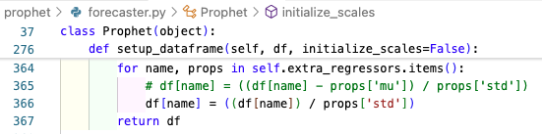
Prophet drawbacks in long-term forecasting…
Overcoming linearity:
Seasonality is inherently non-linear: Fourier Series.
Regressors are linear, we need to make them depict non-linearities
Temperature, HDD, CDD.
x^2 // x^-2 // log(x) // etc.
Too simple hyperparameters optimization:
Integrate HyperOpt into the pipeline.
Holidays not considering DOW.
Tailored DOW-sensitive parameters.
Daily/Weekly Seasonality change through year (Mostly Sat, Sun in GB):
Year-long distributed regressors.
Regressors are standardized around the mean.
Place regressors’ weight depending on its value rather than its deviation from their mean
Notes:
Year-long distributed regressors: All variables need to make sense: daylight hours a day for example.
Regressors:
In sales, a regressor might inherently be positive and negative depending on its distance from its mean.
In power demand forecasting (we have the whole population’s behaviour), I find it more useful to have regressors stirring to either a + or - because of its nominal value, not its deviation from its mean.

Slide 31


GB daily model
I recommend
Example of Prophet’s performance
Regressors’ standardization unchanged

Slide 32
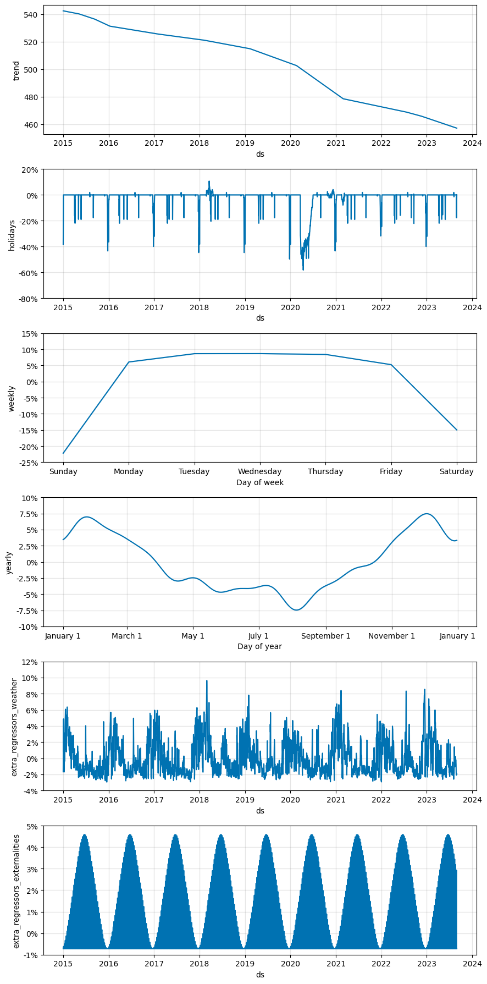
Main Components
Trend, Holidays, Weekly Seasonality
Ad-hoc implementations:
Holidays including day-of-week sensitivity.
Weekdays yearly-changes (by daylight seconds).
Lockdowns’ impact using ”holidays”.
Yearly Seasonality, Weather reg., Weekends reg.
Notes:
The lag-dependencies from an ARIMA model are ”captured” by components: trend, yearly Fourier series.

Slide 33
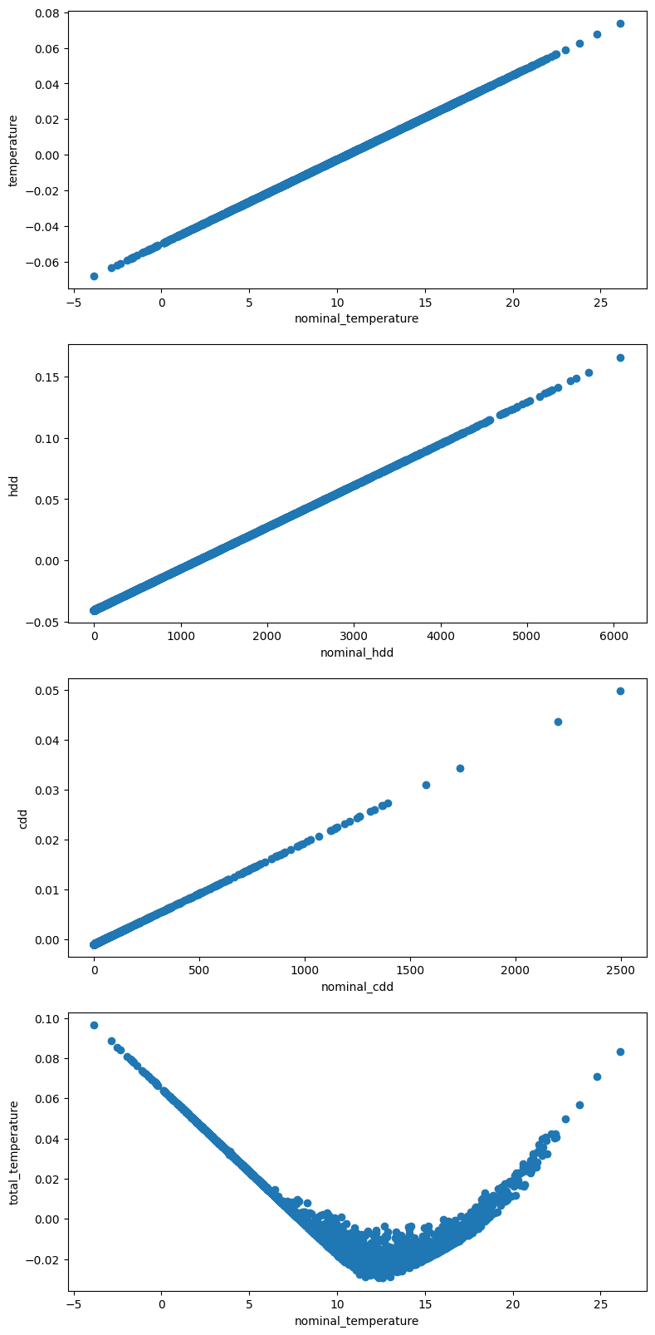
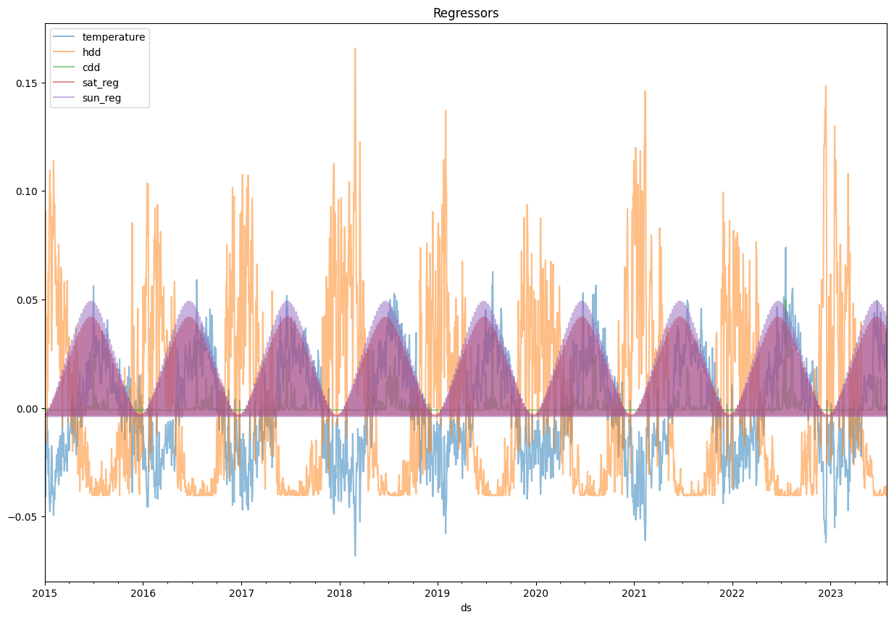
Extra Regressors
Impact on trend by the External Regressors
Notes:
Temperature, hdd and cdd to simulate the non-linear reaction to temperature.
Straight-forward weather-scenarios modelling.
Weather regressors’ impact level at different temperatures

Slide 34
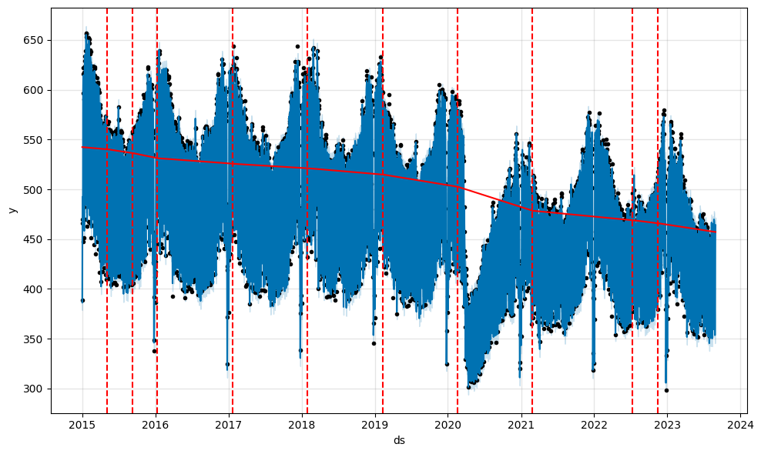
Back-cast and Forecast

Slide 35
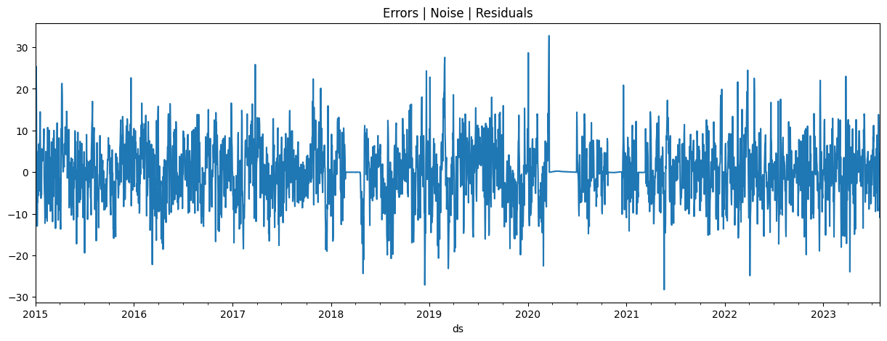
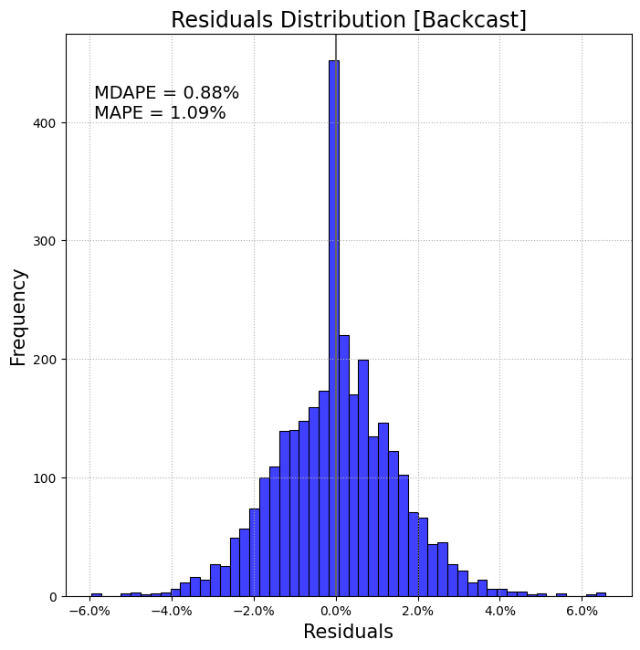
Noise, Error, Residuals from back-casting
By looking at the overall model’s residuals it seems quite stationary → What about by component?
Optimization starts by setting the residual as a normally distributed around 0.

Slide 36
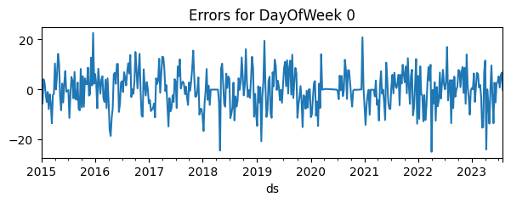
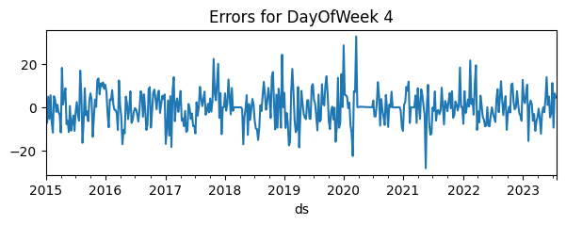
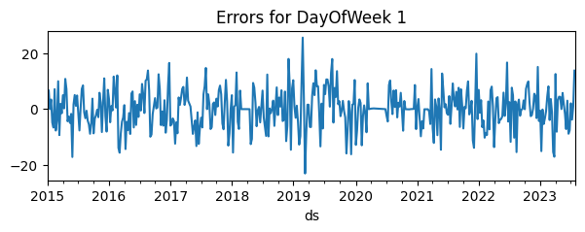
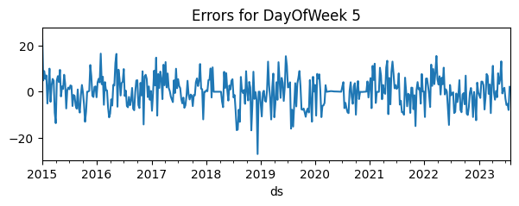
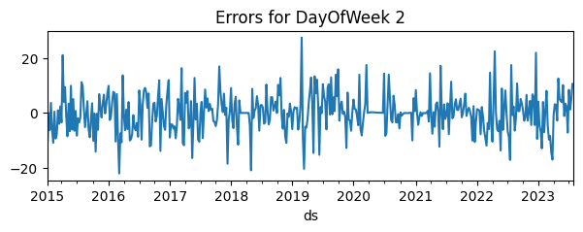


Noise by Day of Week
Example by graphs of how explainable signals not captured by the model can be mathematically captured by refining the model:
We can see some days of the week are less stationary.
Before adding the “daylight_hours” regressor for the weekends → noise was even more seasonal.

Slide 37
Our largest cycle is a year, and we have external factors affecting throughout in different magnitudes: Weather, holidays…
We want to take the variability due to these. Using Prophet outputs, we can:
“Adjust” demand: Take out the effect from the weather regressors.
”Correct” demand: Extrapolate all years to a “standard year”
When forecasting ”corrected” demand, each year’s “standard year weather” will be affecting different day of weeks, making YoY comparisons wrong, etc.
Granular to monthly model
Why 2 models?
In short, we use a high granularity and a monthly model separately because the best high-quality regressors for the modelling are either very granular (weather) or less granular (GDP).
Converting GDP into a daily figure would create noise and mess with the other components of the model
Thoughts on inputs for monthly modelling…
Notes:
So when we have the daily forecast, with all the multiplicative variables’ weights:
We’d be using the adjusted-demand, which is: Trend * (1 + all_variables – (weather + holidays))
When we want to transform the model forecast into a daily forecast, we need to take into account the fact that it incorporates no “signals” from weather/holidays.
So the distribution of x month should sum more than 1, as we’d be adding them back using the “past weather” for Ys or ”forecast weather” Y_hats (Also holidays).
It’d be: Sum( of all days accounting for specified weather and holidays ) / Sum( adjusted demand [which is lower] ).

Slide 38
GB monthly model
Example of Prophet’s performance
Regressors’ standardization [prophet/forecaster.py] unchanged

Slide 39


Main Components using weather/holidays-corrected demand...
Trend, Seasonality+, GDP, anomalies
Left graph:
Seasonality accounts for: leap years, number of weekdays.
Forecast, changepoints, uncertainty-intervals

Slide 40


Extra Regressors and Seasonality
Impact on trend by External Regressors & Yearly Seasonality
Potential further enhancements:
Use working hours of month.
Hours of daylight in a month.
GDP Impact on demand
Extra used regressors:
Binary for leap years.
Number of weekdays.
COVID abnormalities.
Notes:
Weekend days for domestic demand.

Slide 41


Noise, Error, Residuals from back-casting
Optimization starts by setting the residual as a normally distributed around 0.

Slide 42
Some thoughts
Trend, Seasonality+, GDP, anomalies
Interpreting:
As this is a Bayesian optimization model, time is put into the equation as an extra variable. In this context:
If we didn’t have GDP, the trend would need to have lots of changepoints, and it would have less of a downward slope → because time would be catching the “GDP”-related signals.
Therefore, in this example, the trend is depicting everything that isn’t caught by the other model variables:
The efficiency gains throughout GB.
The decarbonization of the GB economy.
The adoption of EVs and Heat pumps.
Behind-the-meter generation.
Etc.
Creating different GDP scenarios is very straightforward as well – and the ability to decompose it into the granular model’s timestep, under different weather scenarios.

Slide 43
GB hourly model
Example of Prophet’s performance
Analysis at an hourly granularity

Slide 44

Some GB demand insights
The north of the country has a higher heating demand [%] than the south during winter. However, its demand varies less with colder temperatures (2015-2023 data).
Domestic: There is higher potential to shift winter demand down South apparently. There isn’t more "electric heating" down South to explain the higher regressors’ magnitude during cold temperatures.
Non-Domestic: Quite a lot aircon demand that could be shifted in summer.

Slide 45

Hourly Modelling
Next article will go into tackling Hourly granularity modelling using Prophet.
Graph showing weather effect at different hours:

